Slide 1
Gamma Distributions and hypothesis testing examples
10/20/2022

Slide 2

Recap
Previously we discussed the Poisson distribution.
$$f\left(k:λ\right)=\frac{λ^{k}e^{−λ}}{k!}$$
or
$$f\left(k:r∗t\right)=\frac{{(r∗t)}^{k}e^{−(r∗t)}}{k!}$$
Where:
$λ$ - average occurrences in a set time period.
k - Number of occurrences in question.
r – rate of occurrences
t – time investigated

Slide 3
Recap
In that discussion we discussed how we might use it to investigate failure times or inform replacement schedules.
This was the example we did at the end of class about the transister.
In this class we’re going to extend that work by deriving the Gamma distribution. This distribution is often used to determine the r’th time an event will occur.

Slide 4
Gamma Distribution
Distribution of times until the 4th pump fails in a system of pumps that ensure cooling of a nuclear reactor.
Distribution of times until the 3rd transistor failure in the auto-pilot system of a commercial aircraft.
Distribution of times until the 8th airbag in a fleet of cars fails.

Slide 5
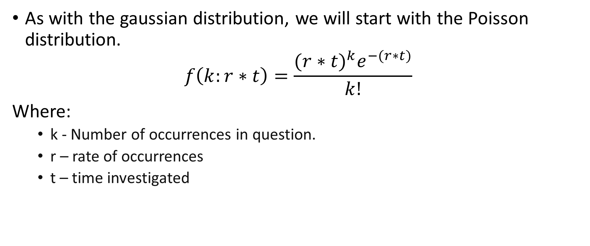
Gamma Distribution - Derivation
As with the gaussian distribution, we will start with the Poisson distribution.
$$f\left(k:r∗t\right)=\frac{{(r∗t)}^{k}e^{−(r∗t)}}{k!}$$
Where:
k - Number of occurrences in question.
r – rate of occurrences
t – time investigated

Slide 6
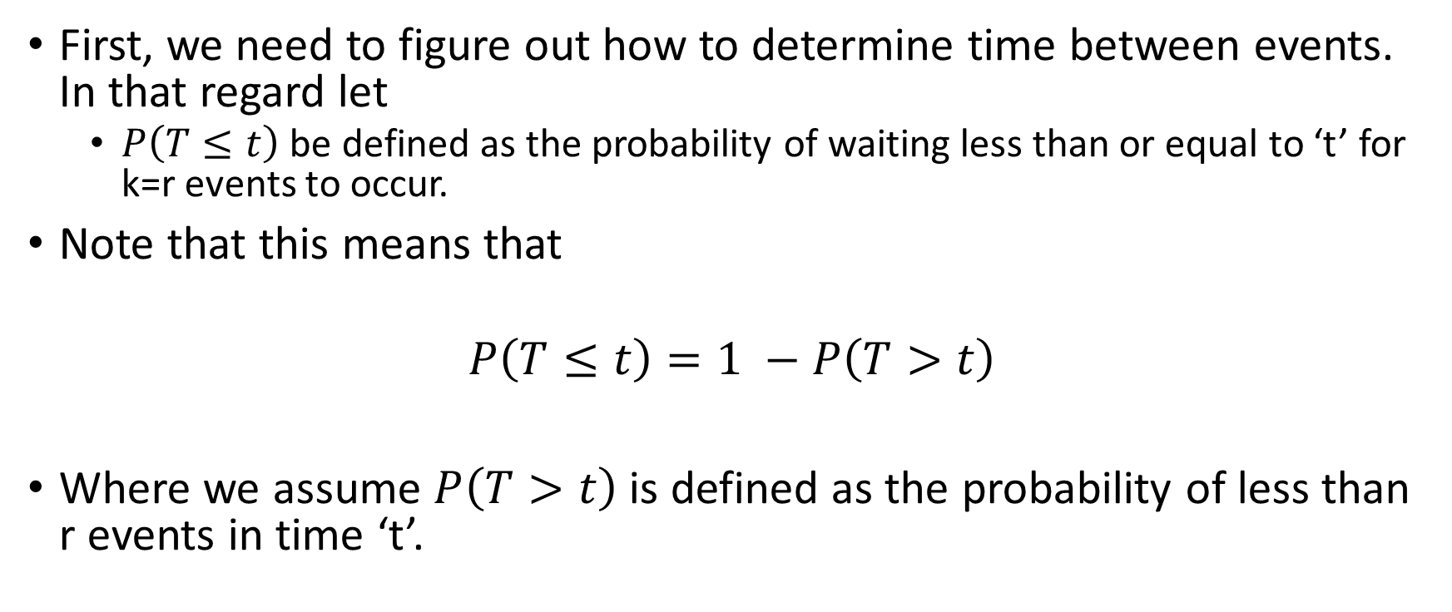
Gamma Distribution - Derivation
First, we need to figure out how to determine time between events. In that regard let
$P\left(T≤t\right)$ be defined as the probability of waiting less than or equal to ‘t’ for k=r events to occur.
Note that this means that
$$P\left(T≤t\right)=1 −P\left(T>t\right)$$
Where we assume $P\left(T>t\right)$ is defined as the probability of less than r events in time ‘t’.

Slide 7

Gamma Distribution - Derivation
$$P\left(T≤t\right)=1 −P\left(T>t\right)$$

Slide 8

Gamma Distribution - Derivation
$$P\left(T≤t\right)=1 −P\left(T>t\right)$$
$$P\left(T≤t\right)=1 −\sum_{k=0}^{k=r−1}{\frac{{(r∗t)}^{k}e^{−(r∗t)}}{k!}}$$
Now please note, $P\left(T≤t\right)$ is a cumulative probability distribution.

Slide 9
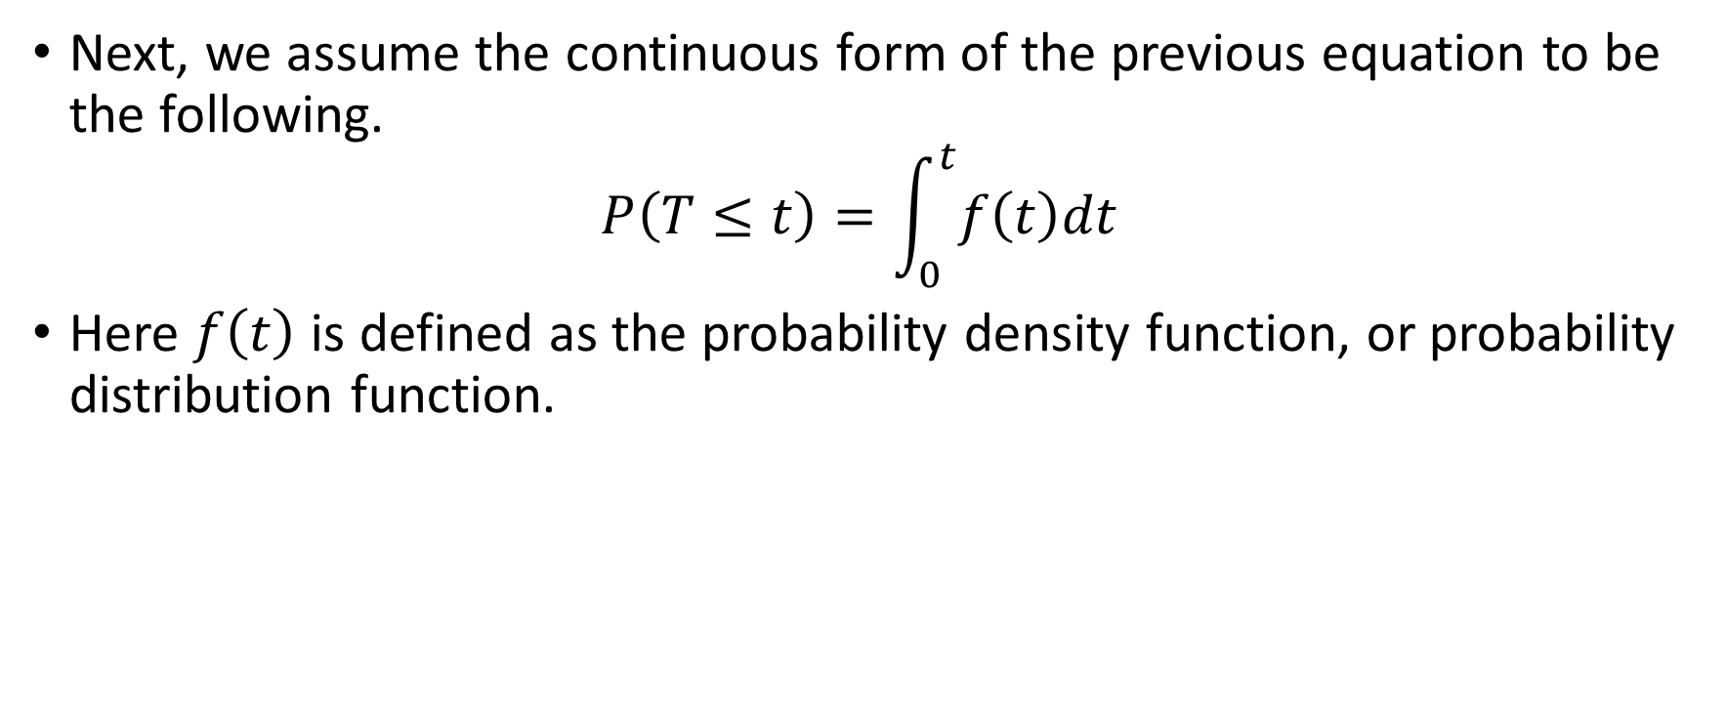
Gamma Distribution – Quick interlude
Next, we assume the continuous form of the previous equation to be the following.
$$P\left(T≤t\right)=\int_{0}^{t}{f\left(t\right)dt}$$
Here $f\left(t\right)$ is defined as the probability density function, or probability distribution function.

Slide 10
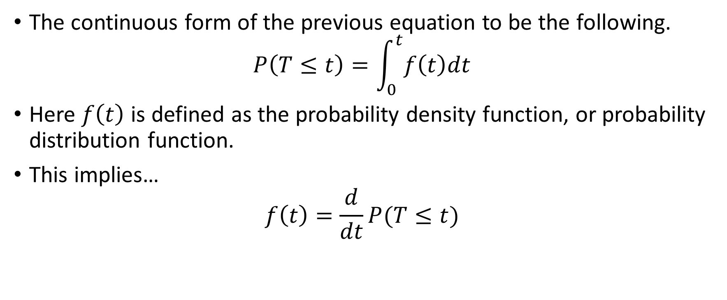
Gamma Distribution - Quick interlude
The continuous form of the previous equation to be the following.
$$P\left(T≤t\right)=\int_{0}^{t}{f\left(t\right)dt}$$
Here $f\left(t\right)$ is defined as the probability density function, or probability distribution function.
This implies…
$$f\left(t\right)=\frac{d}{dt}P(T≤t)$$

Slide 11
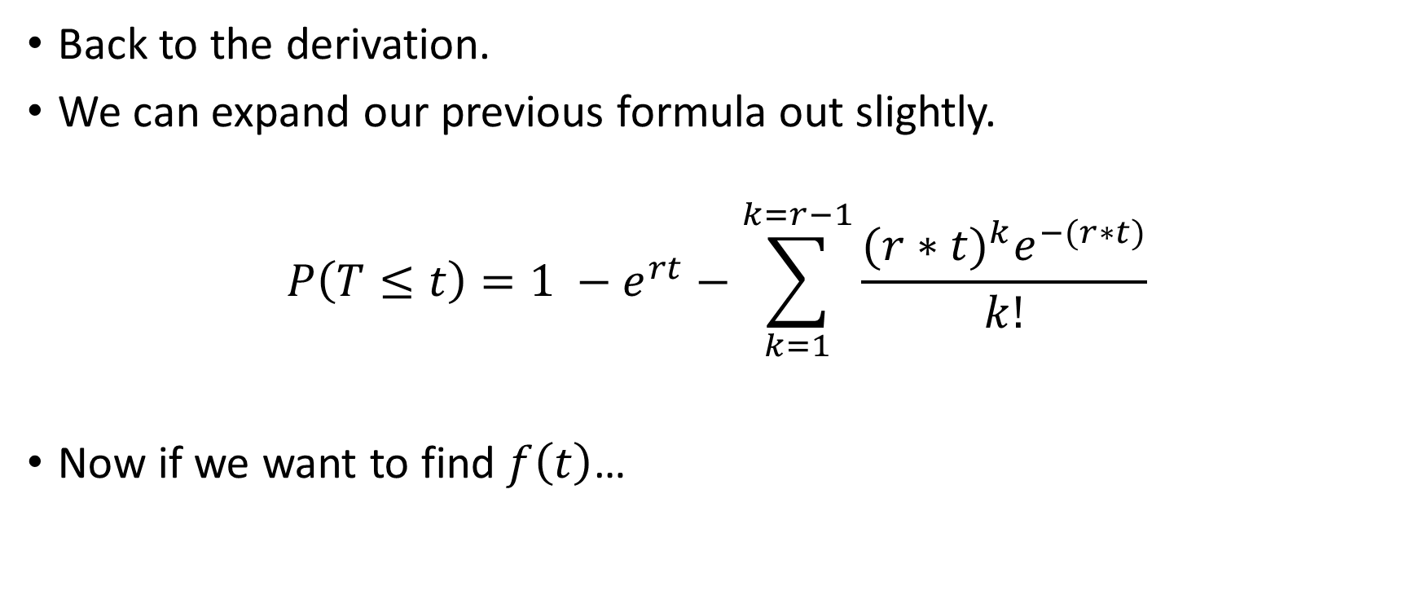
Gamma Distribution - Derivation
Back to the derivation.
We can expand our previous formula out slightly.
$$P\left(T≤t\right)=1 −e^{rt}−\sum_{k=1}^{k=r−1}{\frac{{(r∗t)}^{k}e^{−(r∗t)}}{k!}}$$
Now if we want to find $f\left(t\right)$…

Slide 12
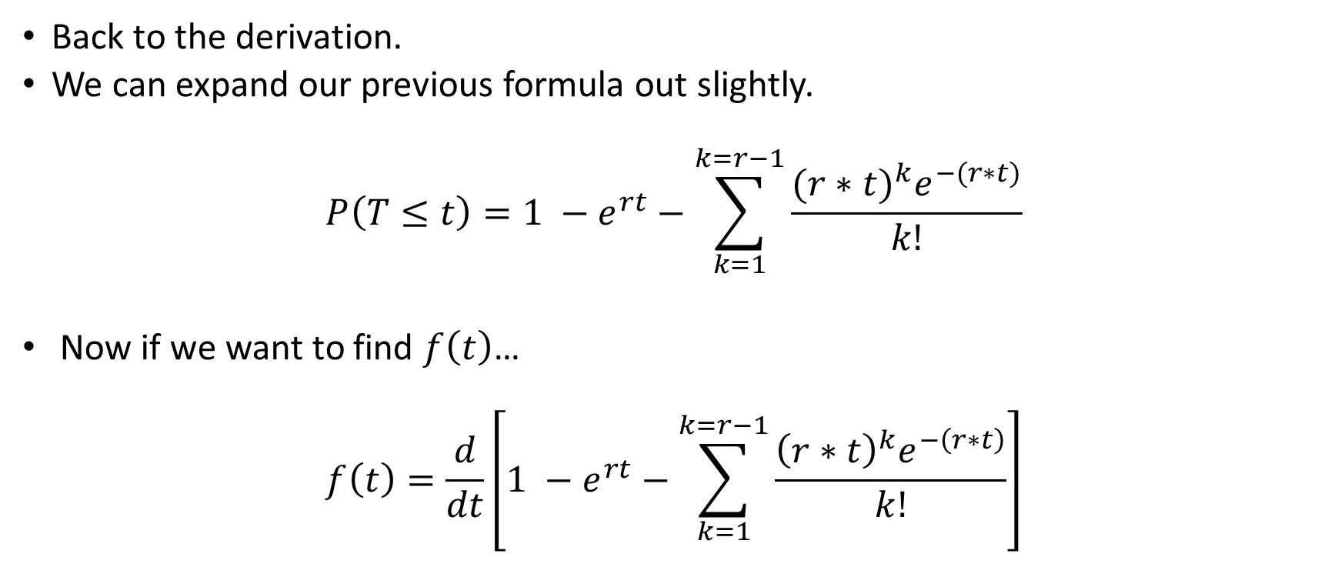
Gamma Distribution - Derivation
Back to the derivation.
We can expand our previous formula out slightly.
$$P\left(T≤t\right)=1 −e^{rt}−\sum_{k=1}^{k=r−1}{\frac{{(r∗t)}^{k}e^{−(r∗t)}}{k!}}$$
Now if we want to find $f\left(t\right)$…
$$f\left(t\right)=\frac{d}{dt}\left[1 −e^{rt}−\sum_{k=1}^{k=r−1}{\frac{{\left(r∗t\right)}^{k}e^{−\left(r∗t\right)}}{k!}}\right]$$

Slide 13

Gamma Distribution - Derivation
$$f\left(t\right)=\frac{d}{dt}\left[1 −e^{rt}−\sum_{k=1}^{k=r−1}{\frac{{\left(r∗t\right)}^{k}e^{−\left(r∗t\right)}}{k!}}\right]$$

Slide 14

Gamma Distribution - Derivation
$$f\left(t\right)=\frac{d}{dt}\left[1 −e^{−rt}−\sum_{k=1}^{k=r−1}{\frac{{\left(r∗t\right)}^{k}e^{−\left(r∗t\right)}}{k!}}\right]$$
$$f\left(t\right)=re^{−rt}−\left\{\frac{d}{dt}\left[\sum_{k=1}^{k=r−1}{\frac{{\left(r∗t\right)}^{k}e^{−\left(r∗t\right)}}{k!}}\right]\right\}$$

Slide 15

Gamma Distribution - Derivation
$$\frac{d}{dt}\left[\sum_{k=1}^{k=r−1}{\frac{{\left(r∗t\right)}^{k}e^{−\left(r∗t\right)}}{k!}}\right]= ?$$

Slide 16

Gamma Distribution - Derivation
$$\frac{d}{dt}\left[\sum_{k=1}^{k=r−1}{\frac{{\left(r∗t\right)}^{k}e^{−\left(r∗t\right)}}{k!}}\right]=\sum_{k=1}^{k=r−1}{\frac{1}{k!}\left\{\frac{d}{dt}\left[(r{t)}^{k}\right]∗e^{−rt}+\frac{d}{dt}\left[e^{−rt}\right]∗(r{t)}^{k}\right\}}$$

Slide 17
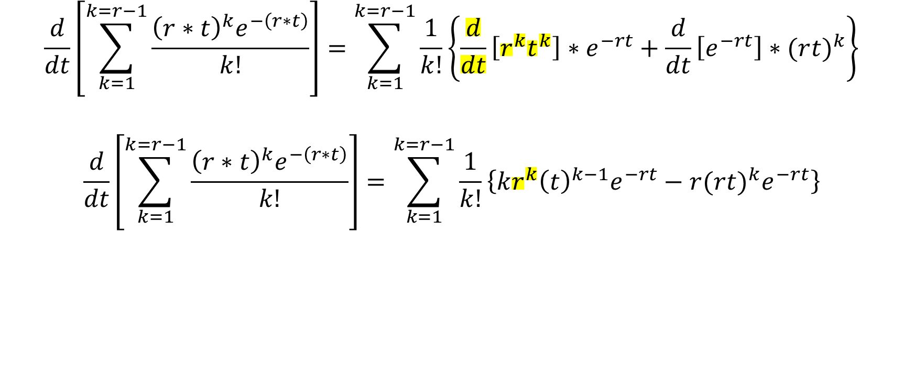
Gamma Distribution - Derivation
$$\frac{d}{dt}\left[\sum_{k=1}^{k=r−1}{\frac{{\left(r∗t\right)}^{k}e^{−\left(r∗t\right)}}{k!}}\right]=\sum_{k=1}^{k=r−1}{\frac{1}{k!}\left\{\frac{d}{dt}\left[r^{k}t^{k}\right]∗e^{−rt}+\frac{d}{dt}\left[e^{−rt}\right]∗(r{t)}^{k}\right\}}$$
$$\frac{d}{dt}\left[\sum_{k=1}^{k=r−1}{\frac{{\left(r∗t\right)}^{k}e^{−\left(r∗t\right)}}{k!}}\right]=\sum_{k=1}^{k=r−1}{\frac{1}{k!}\left\{kr^{k}{\left(t\right)}^{k−1}e^{−rt}−r(r{t)}^{k}e^{−rt}\right\}}$$

Slide 18
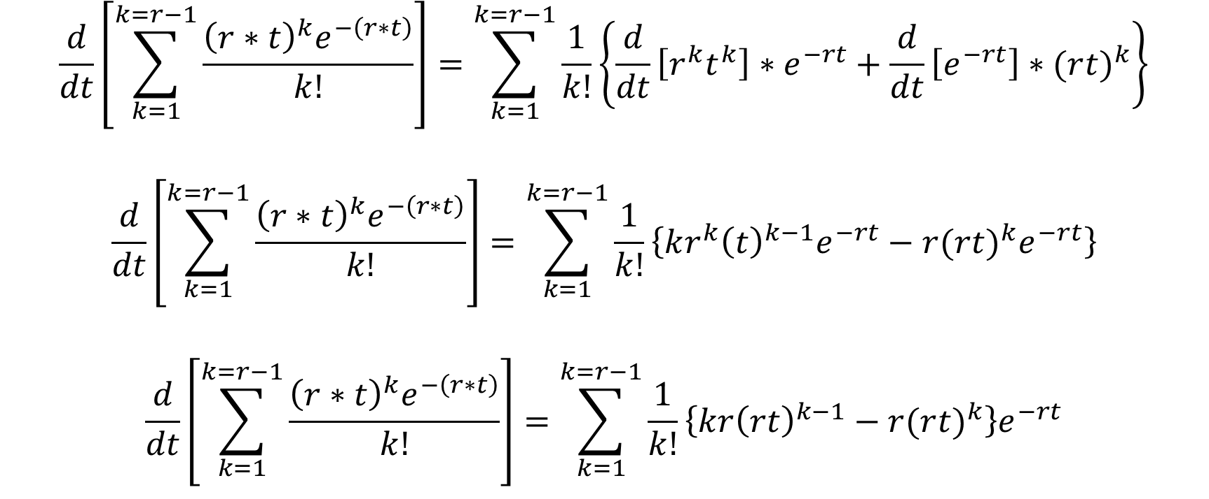
Gamma Distribution - Derivation
$$\frac{d}{dt}\left[\sum_{k=1}^{k=r−1}{\frac{{\left(r∗t\right)}^{k}e^{−\left(r∗t\right)}}{k!}}\right]=\sum_{k=1}^{k=r−1}{\frac{1}{k!}\left\{\frac{d}{dt}\left[r^{k}t^{k}\right]∗e^{−rt}+\frac{d}{dt}\left[e^{−rt}\right]∗(r{t)}^{k}\right\}}$$
$$\frac{d}{dt}\left[\sum_{k=1}^{k=r−1}{\frac{{\left(r∗t\right)}^{k}e^{−\left(r∗t\right)}}{k!}}\right]=\sum_{k=1}^{k=r−1}{\frac{1}{k!}\left\{k{r^{k}\left(t\right)}^{k−1}e^{−rt}−r(r{t)}^{k}e^{−rt}\right\}}$$
$$\frac{d}{dt}\left[\sum_{k=1}^{k=r−1}{\frac{{\left(r∗t\right)}^{k}e^{−\left(r∗t\right)}}{k!}}\right]=\sum_{k=1}^{k=r−1}{\frac{1}{k!}\left\{kr{\left(rt\right)}^{k−1}−r(r{t)}^{k}\right\}e^{−rt}}$$

Slide 19

Gamma Distribution - Derivation
$$\frac{d}{dt}\left[\sum_{k=1}^{k=r−1}{\frac{{\left(r∗t\right)}^{k}e^{−\left(r∗t\right)}}{k!}}\right]=\sum_{k=1}^{k=r−1}{\frac{1}{k!}\left\{k{\left(rt\right)}^{k−1}−(r{t)}^{k}\right\}{re}^{−rt}}$$

Slide 20
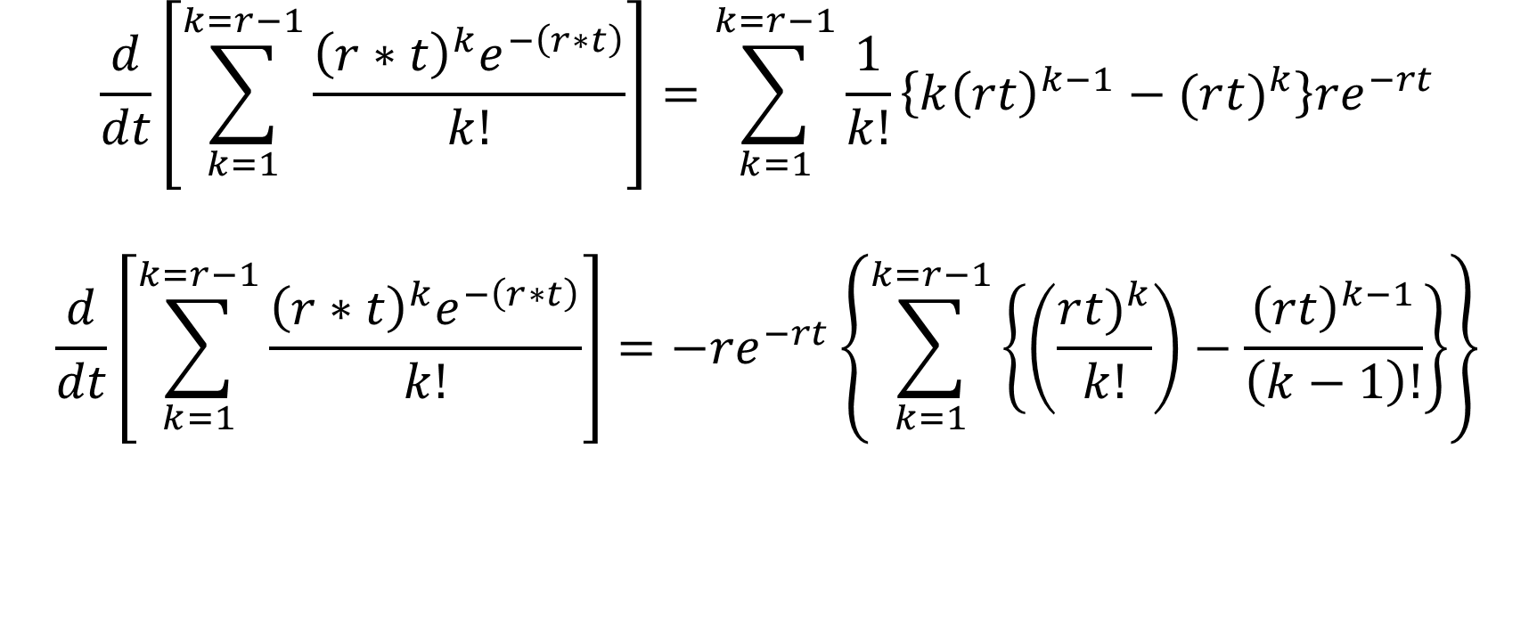
Gamma Distribution - Derivation
$$\frac{d}{dt}\left[\sum_{k=1}^{k=r−1}{\frac{{\left(r∗t\right)}^{k}e^{−\left(r∗t\right)}}{k!}}\right]=\sum_{k=1}^{k=r−1}{\frac{1}{k!}\left\{k{\left(rt\right)}^{k−1}−(r{t)}^{k}\right\}{re}^{−rt}}$$
$$\frac{d}{dt}\left[\sum_{k=1}^{k=r−1}{\frac{{\left(r∗t\right)}^{k}e^{−\left(r∗t\right)}}{k!}}\right]={−re}^{−rt}\left\{\sum_{k=1}^{k=r−1}{\left\{\left(\frac{r{t)}^{k}}{k!}\right)−\frac{{\left(rt\right)}^{k−1}}{\left(k−1\right)!}\right\}}\right\}$$

Slide 21

Gamma Distribution - Derivation
$$\left\{\sum_{k=1}^{k=r−1}{\left\{\left(\frac{(r{t)}^{k}}{k!}\right)−\frac{{\left(rt\right)}^{k−1}}{\left(k−1\right)!}\right\}}\right\}=\left[rt −1\right]+\left[\frac{{\left(rt\right)}^{2}}{2} −rt\right]+$$

Slide 22

Gamma Distribution - Derivation
$$\left\{\sum_{k=1}^{k=r−1}{\left\{\left(\frac{(r{t)}^{k}}{k!}\right)−\frac{{\left(rt\right)}^{k−1}}{\left(k−1\right)!}\right\}}\right\}=\left[\frac{rt}{1!} −1\right]+\left[\frac{{\left(rt\right)}^{2}}{2!} −rt\right]+ \left[\frac{{\left(rt\right)}^{3}}{3!} −\frac{{\left(rt\right)}^{2}}{2!}\right]$$

Slide 23

Gamma Distribution - Derivation
$$\left\{\sum_{k=1}^{k=r−1}{\left\{\left(\frac{(r{t)}^{k}}{k!}\right)−\frac{{\left(rt\right)}^{k−1}}{\left(k−1\right)!}\right\}}\right\}=\left[\frac{rt}{1!} −1\right]+\left[\frac{{\left(rt\right)}^{2}}{2!} −rt\right]+ \left[\frac{{\left(rt\right)}^{3}}{3!} −\frac{{\left(rt\right)}^{2}}{2!}\right]+ \left[\frac{{\left(rt\right)}^{4}}{4!} −\frac{{\left(rt\right)}^{3}}{3!}\right]$$

Slide 24
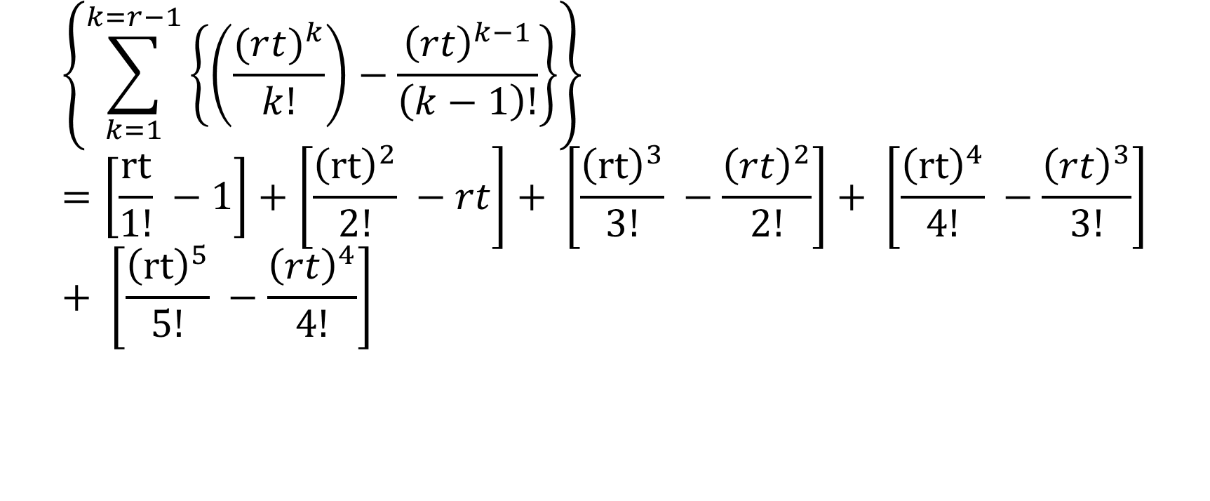
Gamma Distribution - Derivation
$$\left\{\sum_{k=1}^{k=r−1}{\left\{\left(\frac{(r{t)}^{k}}{k!}\right)−\frac{{\left(rt\right)}^{k−1}}{\left(k−1\right)!}\right\}}\right\}=\left[\frac{rt}{1!} −1\right]+\left[\frac{{\left(rt\right)}^{2}}{2!} −rt\right]+ \left[\frac{{\left(rt\right)}^{3}}{3!} −\frac{{\left(rt\right)}^{2}}{2!}\right]+ \left[\frac{{\left(rt\right)}^{4}}{4!} −\frac{{\left(rt\right)}^{3}}{3!}\right]+ \left[\frac{{\left(rt\right)}^{5}}{5!} −\frac{{\left(rt\right)}^{4}}{4!}\right]$$

Slide 25
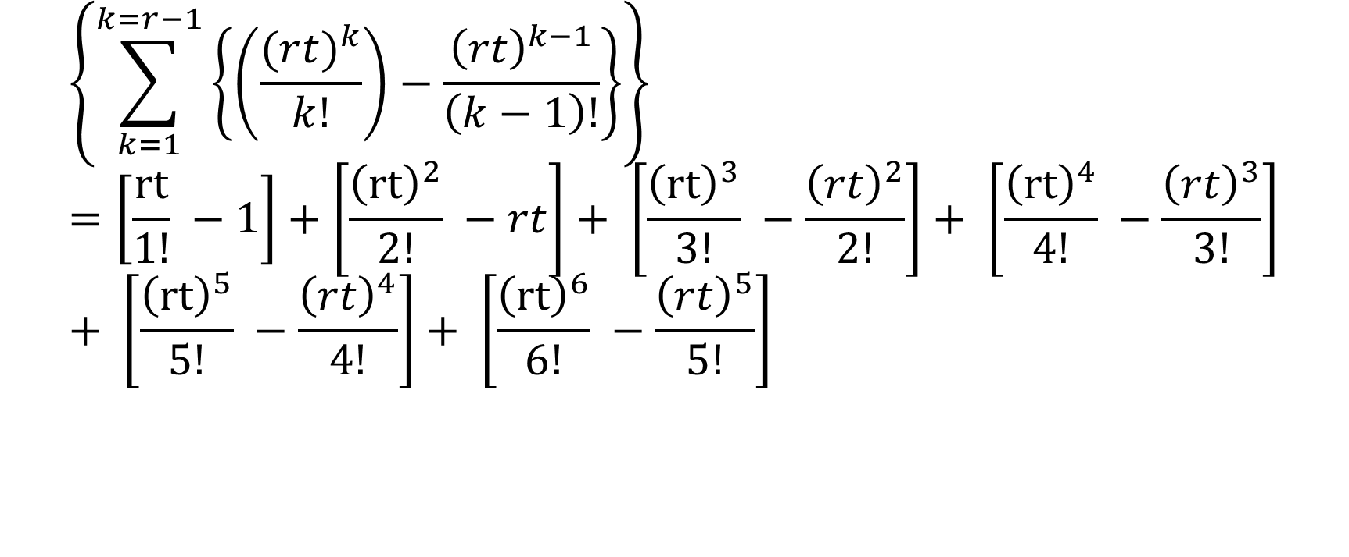
Gamma Distribution - Derivation
$$\left\{\sum_{k=1}^{k=r−1}{\left\{\left(\frac{(r{t)}^{k}}{k!}\right)−\frac{{\left(rt\right)}^{k−1}}{\left(k−1\right)!}\right\}}\right\}=\left[\frac{rt}{1!} −1\right]+\left[\frac{{\left(rt\right)}^{2}}{2!} −rt\right]+ \left[\frac{{\left(rt\right)}^{3}}{3!} −\frac{{\left(rt\right)}^{2}}{2!}\right]+ \left[\frac{{\left(rt\right)}^{4}}{4!} −\frac{{\left(rt\right)}^{3}}{3!}\right]+ \left[\frac{{\left(rt\right)}^{5}}{5!} −\frac{{\left(rt\right)}^{4}}{4!}\right]+ \left[\frac{{\left(rt\right)}^{6}}{6!} −\frac{{\left(rt\right)}^{5}}{5!}\right]$$

Slide 26
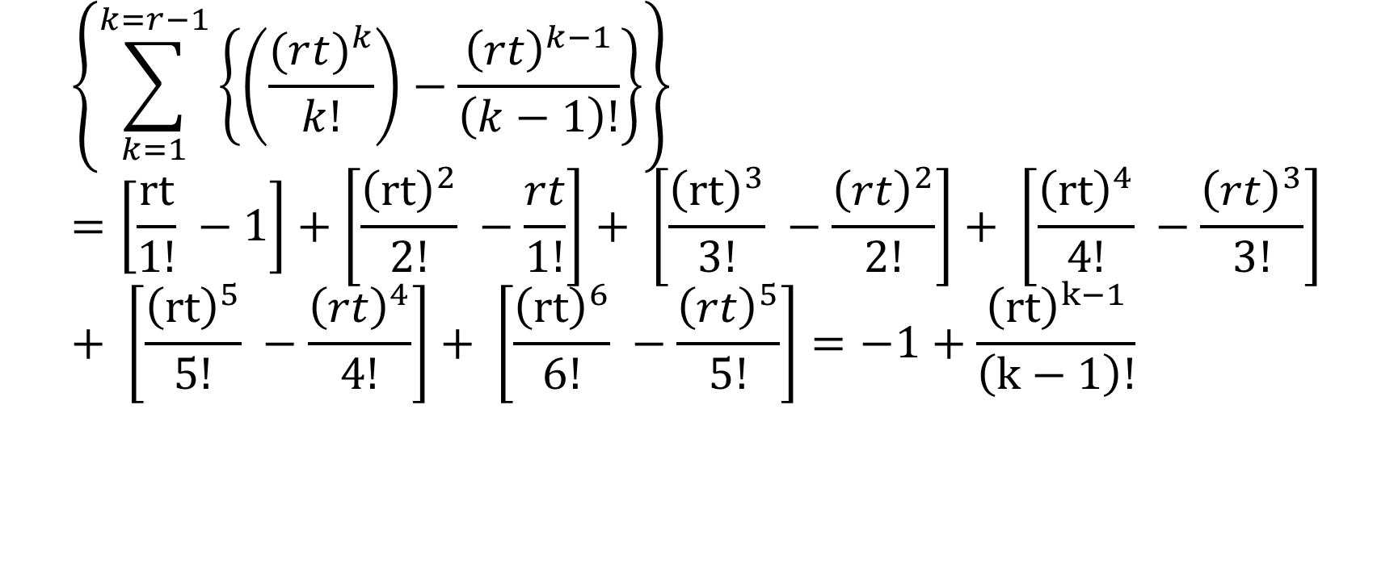
Gamma Distribution - Derivation
$$\left\{\sum_{k=1}^{k=r−1}{\left\{\left(\frac{(r{t)}^{k}}{k!}\right)−\frac{{\left(rt\right)}^{k−1}}{\left(k−1\right)!}\right\}}\right\}=\left[\frac{rt}{1!} −1\right]+\left[\frac{{\left(rt\right)}^{2}}{2!} −\frac{rt}{1!}\right]+ \left[\frac{{\left(rt\right)}^{3}}{3!} −\frac{{\left(rt\right)}^{2}}{2!}\right]+ \left[\frac{{\left(rt\right)}^{4}}{4!} −\frac{{\left(rt\right)}^{3}}{3!}\right]+ \left[\frac{{\left(rt\right)}^{5}}{5!} −\frac{{\left(rt\right)}^{4}}{4!}\right]+ \left[\frac{{\left(rt\right)}^{6}}{6!} −\frac{{\left(rt\right)}^{5}}{5!}\right]=−1+\frac{{\left(rt\right)}^{k−1}}{\left(k−1\right)!}$$

Slide 27
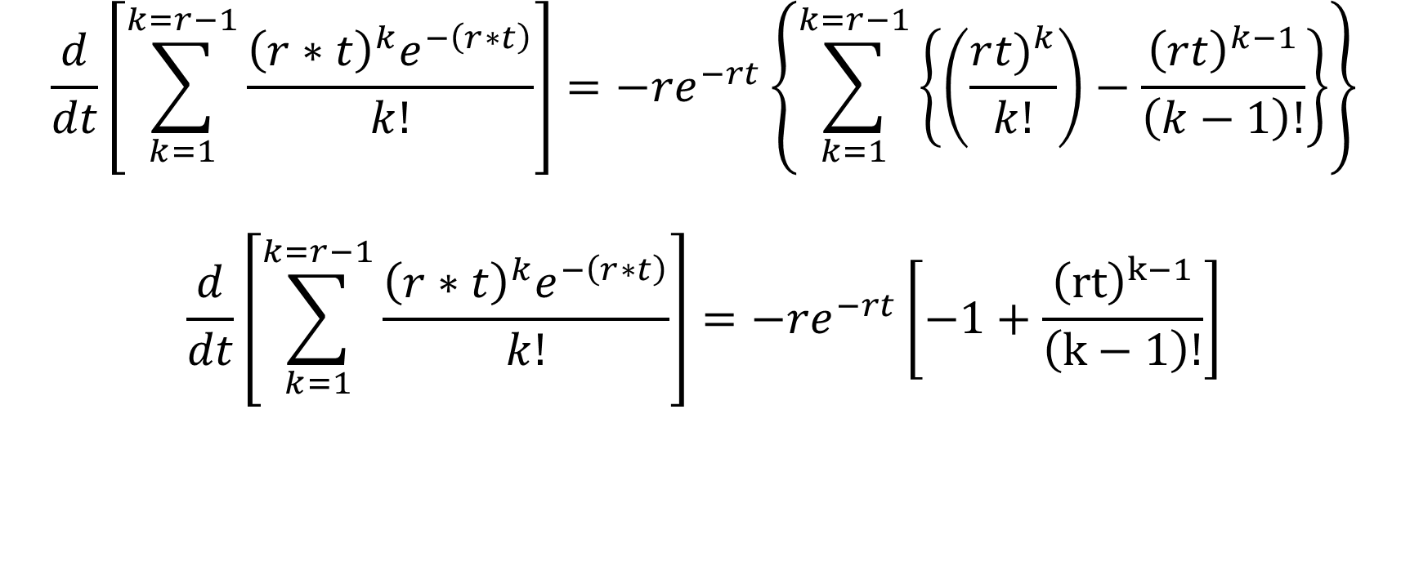
Gamma Distribution - Derivation
$$\frac{d}{dt}\left[\sum_{k=1}^{k=r−1}{\frac{{\left(r∗t\right)}^{k}e^{−\left(r∗t\right)}}{k!}}\right]={−re}^{−rt}\left\{\sum_{k=1}^{k=r−1}{\left\{\left(\frac{r{t)}^{k}}{k!}\right)−\frac{{\left(rt\right)}^{k−1}}{\left(k−1\right)!}\right\}}\right\}$$
$$\frac{d}{dt}\left[\sum_{k=1}^{k=r−1}{\frac{{\left(r∗t\right)}^{k}e^{−\left(r∗t\right)}}{k!}}\right]={−re}^{−rt}\left[−1+\frac{{\left(rt\right)}^{k−1}}{\left(k−1\right)!}\right]$$

Slide 28
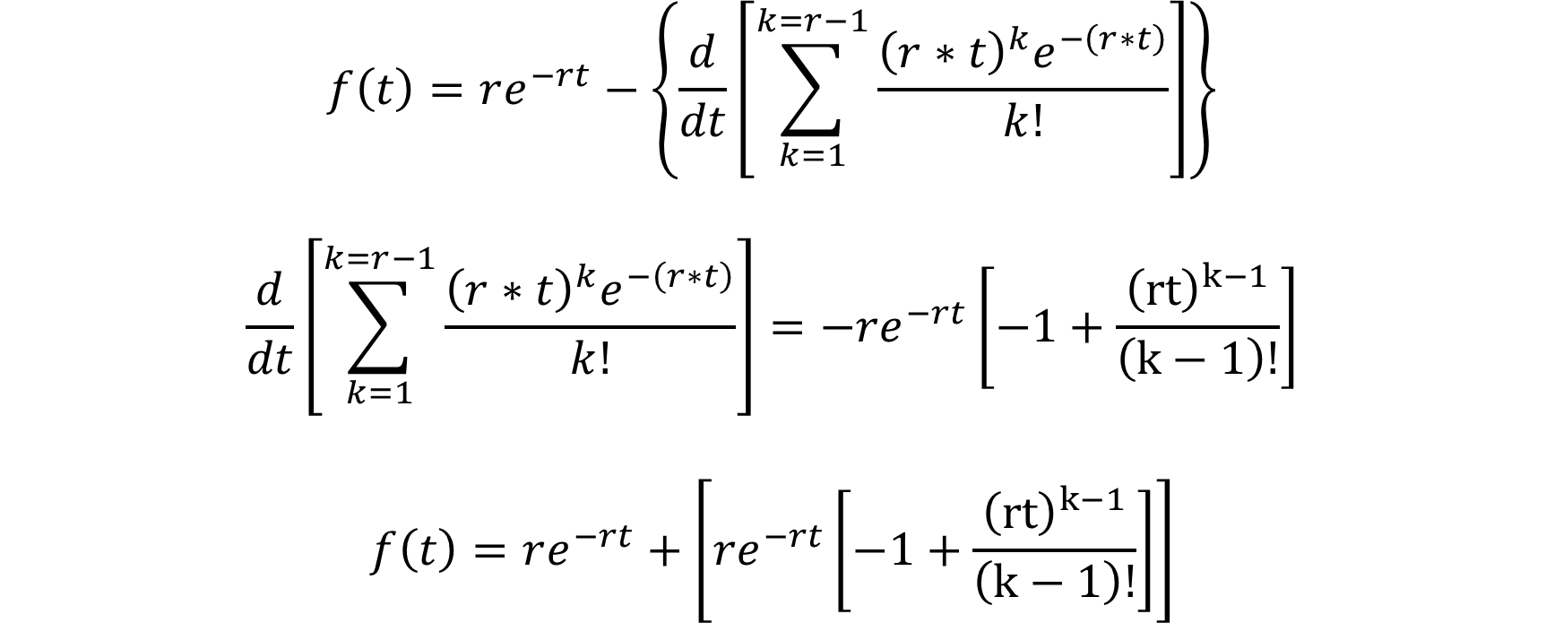
Gamma Distribution - Derivation
$$f\left(t\right)=re^{−rt}−\left\{\frac{d}{dt}\left[\sum_{k=1}^{k=r−1}{\frac{{\left(r∗t\right)}^{k}e^{−\left(r∗t\right)}}{k!}}\right]\right\}$$
$$\frac{d}{dt}\left[\sum_{k=1}^{k=r−1}{\frac{{\left(r∗t\right)}^{k}e^{−\left(r∗t\right)}}{k!}}\right]={−re}^{−rt}\left[−1+\frac{{\left(rt\right)}^{k−1}}{\left(k−1\right)!}\right]$$
$$f\left(t\right)=re^{−rt}+\left[{re}^{−rt}\left[−1+\frac{{\left(rt\right)}^{k−1}}{\left(k−1\right)!}\right]\right]$$

Slide 29

Gamma Distribution - Derivation
$$f\left(t\right)=re^{−rt}+\left[{re}^{−rt}\left[−1+\frac{{\left(rt\right)}^{k−1}}{\left(k−1\right)!}\right]\right]$$
$$f\left(t\right)=re^{−rt} − {re}^{−rt}+\frac{{\left(rt\right)}^{k−1}}{\left(k−1\right)!}{re}^{−rt}$$
$$f\left(t\right)=\frac{{{re}^{−rt}\left(rt\right)}^{k−1}}{\left(k−1\right)!}$$

